Slide 1
Connection lost
Too many people, too little WIFI
By the New York Rat, Sydney Gardner

Slide 2
Preface
When COVID-19 hit, servers were flooded with the amount of people all suddenly going online. Between streaming services, digital hangouts, and online classes, it’s hard to keep up with all the requests.
This poor little server has the worst of it, only being able to maintain three connections at a time. How long can it keep up?

Slide 3
Feature List
This is an arcade-style game; you play until you lose.
Gets progressively difficult at more computers show up.
Score is dictated by how long you can survive times how many computers you have at the moment.
If even one customer complains, you lose.

Slide 4
Gameplay Part I
Use the mouse to create connections between your server and the computers around it (Maximum of 3 connections at a time).
If the computer is connected, the screen will slowly turn green, indicating satisfaction.
If the computer is not connected, the screen will slowly turn red, indicating dissatisfaction.
If even one computer turns completely red, it’s game over.

Slide 5
Gameplay Part II
More computers will show up over time, so you have to manage how much time you let each computer connect.
The score will be indicated in the Status Bar.
The score is the number of computers you’ve been able to keep happy.

Slide 6
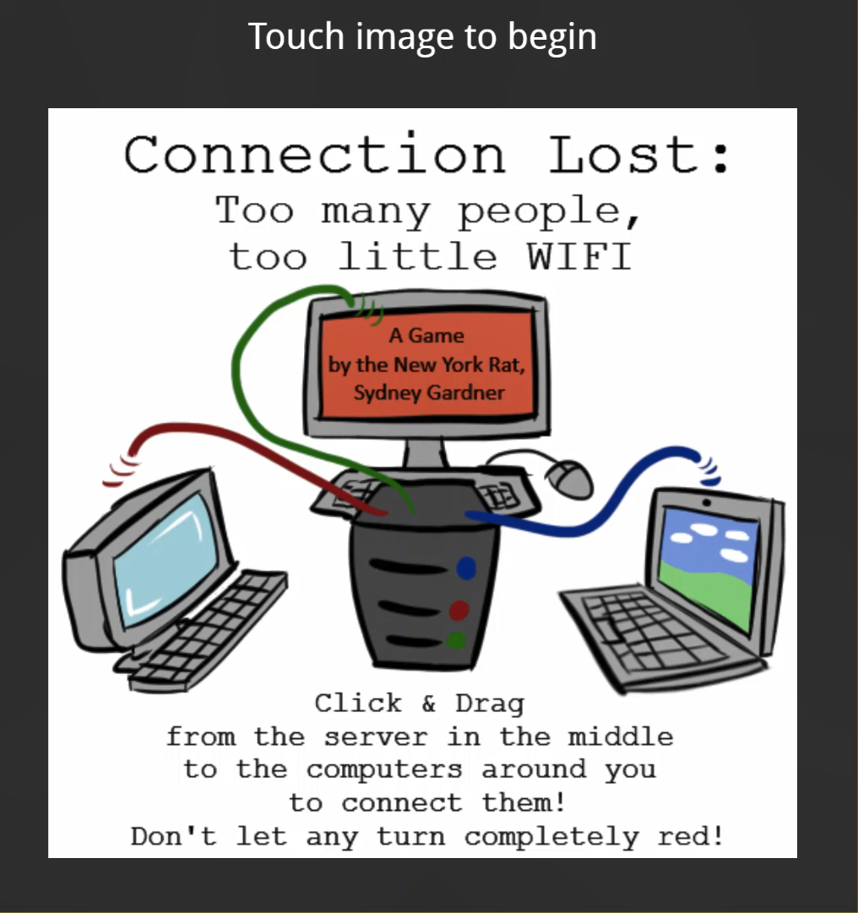
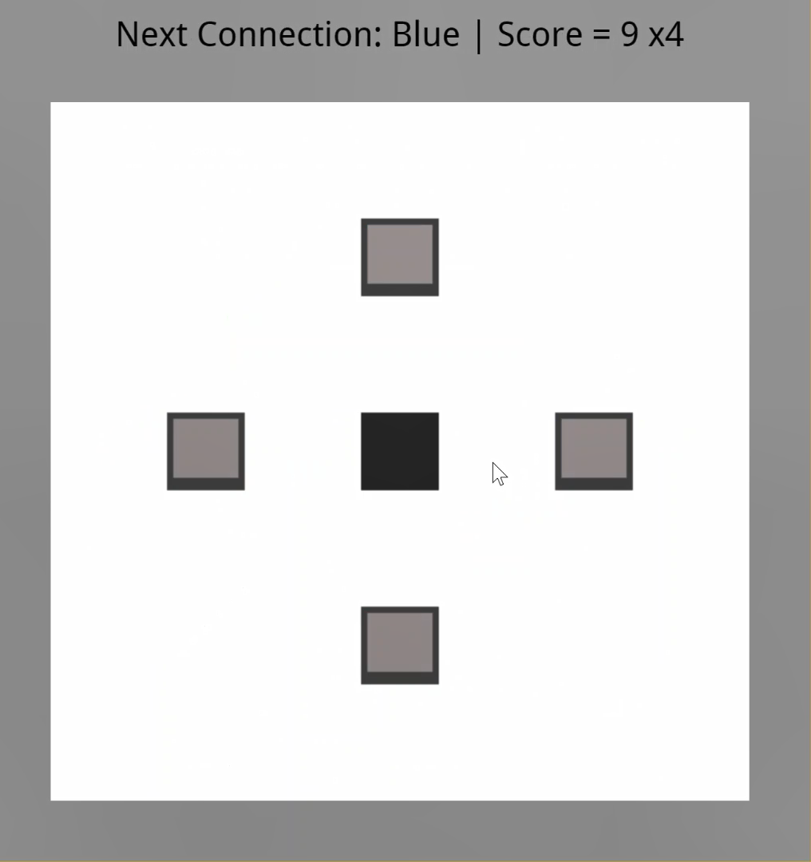
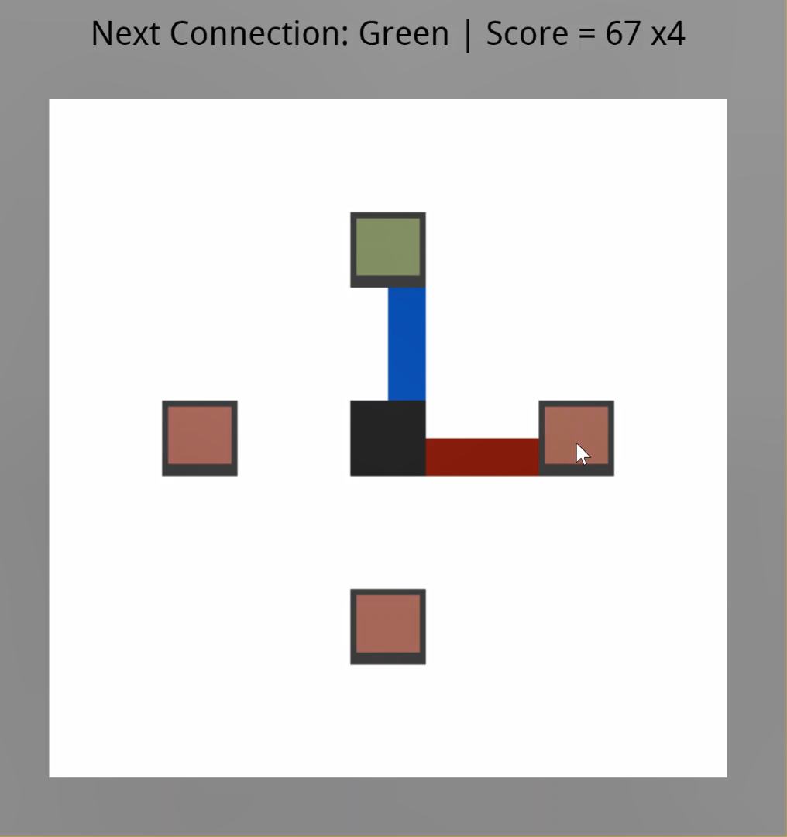
Screenshots
The cover image with instruction
Start of the game
Making connections.
The blue is already affecting the attached computer

Slide 7
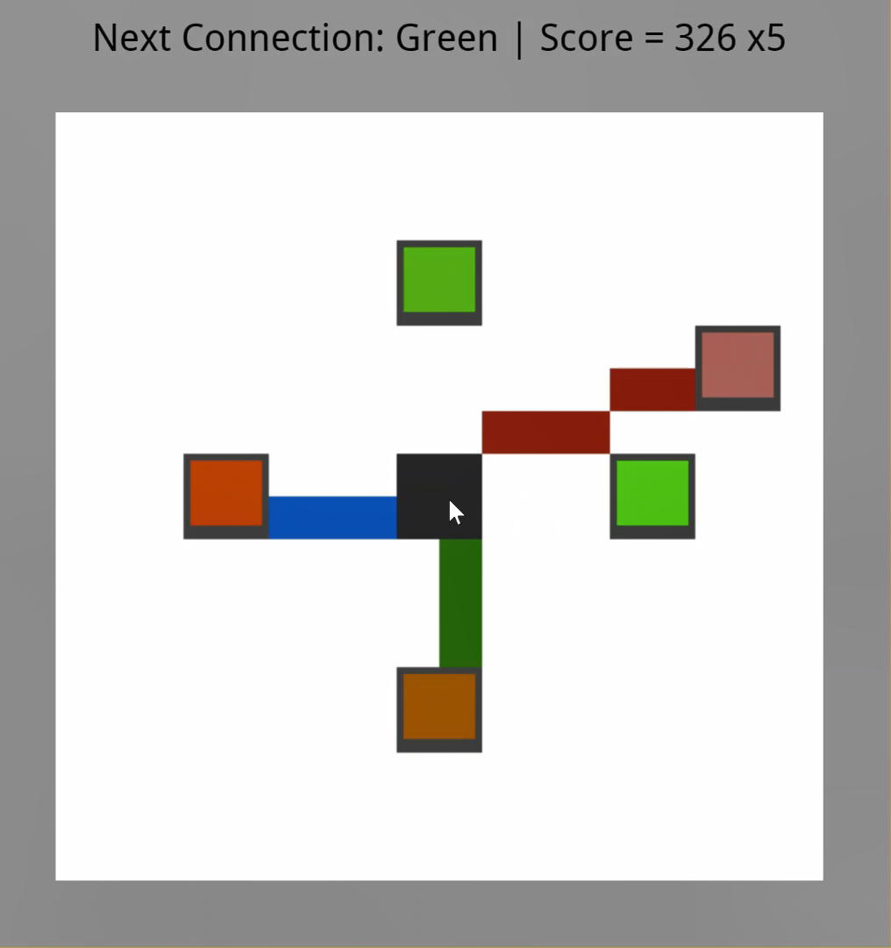
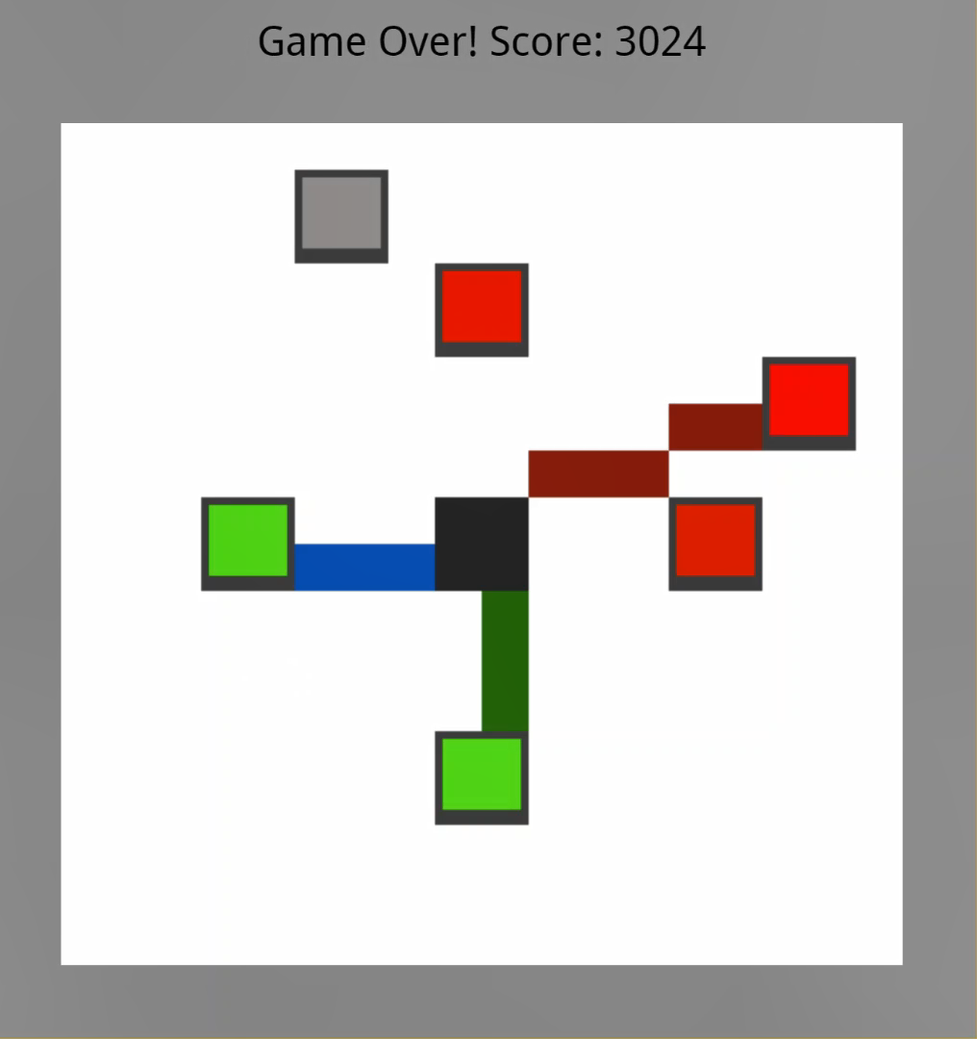
Screenshots
A maximum of
three connections can be drawn at a time
Shows the game over

Slide 8
Survey Responses:
The first prototype was really rough, and people were expectedly confused or frustrated with the lack of function.
The second prototype had more functionality and it was actually possible to not game over immediately.
That being said, there were still comments and suggestions I took into account for the final.
As an extra note: I mixed up my own title, and the prototypes were accidentally called “Lost Connections” instead of “Connection Lost”

Slide 9
Changes from Original I:
Many people were confused about how to play, so I tried to make my cover more coherent in explaining the game.
Though there were people asking to add more connections or asking for a “win” condition, the point is that there are limited resources and the server cannot go on forever. This was never meant to have a solid “win” state. However, I made it so that the rate at which computers complain and how quickly they are satisfied adjust to the amount of computers on screen, so it is more fair to the player.

Slide 10
Changes from Original II:
There is a maximum amount of computers that will appear (there can be up to 16 computers on screen at once). They have set places, but the order they appear is random.
Sound effects were added
The connections have defined colors, and the status line indicates which connection will move next.

Slide 11
Artist Statement
This game is meant to be a fun way to pass the time. It’s meant to be a resource management game with a lot of replayability.
It shows how even a resource as seemingly infinite as the internet can be spread too thin.
(and my high score is 6105)

Slide 12
Persistent Bugs:
Unfortunately, there are two bugs that I couldn’t find the source of.
One was a visual glitch; when the line disconnected from a computer, a bead or two would remain. Functionally the game knows it is disconnected, but I am uncertain why this has occurred.
The other was a glitch where a computer’s “screen” becomes disjointed and the beads change color at different rates. This especially seemed to happen on the 9th computer to show up. I cannot seem to find why.
I am sorry that the causes of these were not located.

